Slide 1
Parliamentary Stayers in Western Democracies: Mind the Gender-Gap in Political Endurance Ragnhild Muriaas & Torill Stavenes, CEE General Seminar, 22.11.2022
*Work in progress: Please note that the measurements are adjusted in later versions.

Slide 2
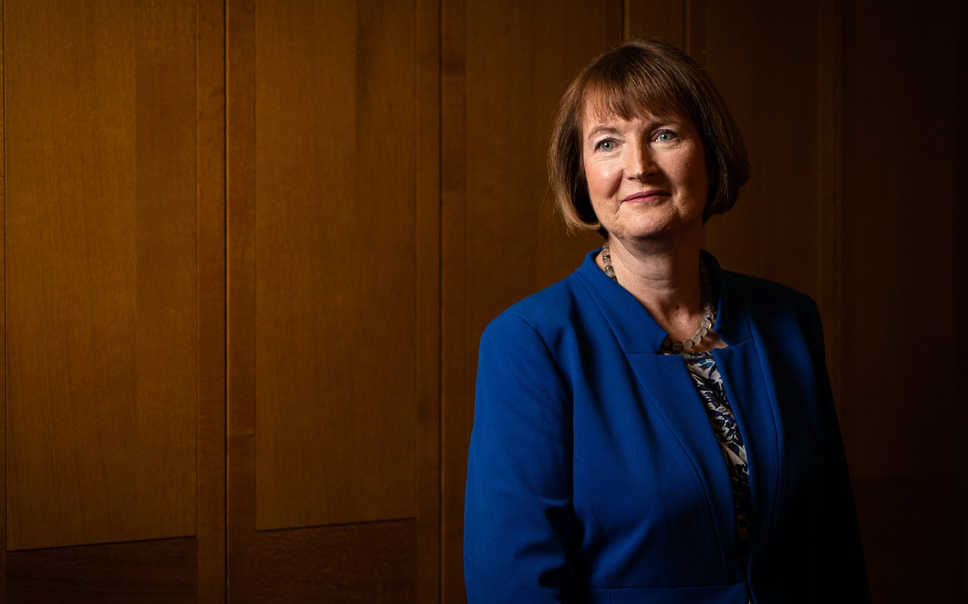
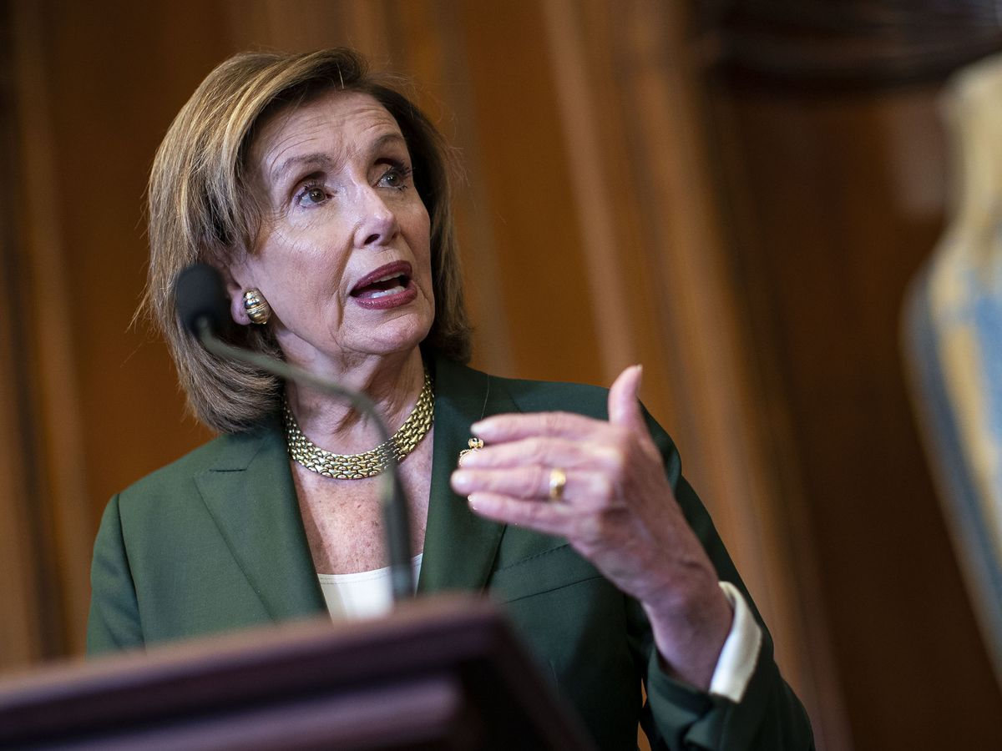
Foto: VG
Foto: The Independent
Foto: Bloomberg
Notes:
Erna Solberg, elected member of the Storting since 1989
Harriet Harman, been a MP since 1982. Not standing in the next general election. Longest serving female MP in britain
Nancy Pelosi, been a congresswoman since 1987
How common is it for women politicians to become parliamentary stayers? What should we do to find out if there is a gender-gap in political endurance and whether it varies across time and country?
These are questions that we are aiming to tackle in this paper – and in this presentation

Slide 3
How common are women among parliamentary stayers?

Slide 4
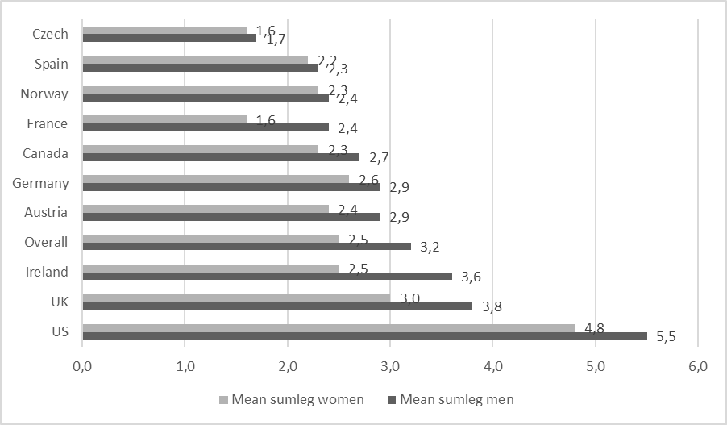
Gender differences in average length of career?

Slide 5
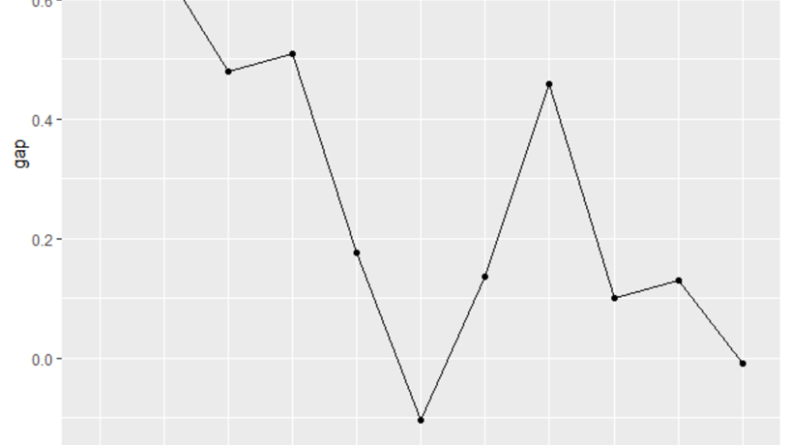
Is there much difference left to talk about?

Slide 6
Backdrop: What is gender balance?
Numeric representation of women:
Why does it matter?
Policy input (Mansbridge, 1999; Franceschet and Piscopo, 2014)
Legitimacy (Clayton et al, 2019; Arnesen and Peters, 2018)
Notes:
There has been a stark increase in the number of female representatives in parliaments across the globe in the previous decades, even though the gender gap is still substantial in most contexts.
This is also reflected in political science: In the last couple of decades there has been an unprecedented interest in the numeric gender imbalance in national parliaments across the world.
WHY? Well, because numeric representation matters: The argument is that: if women are not represented equally with men, their preferences are not likely to be given properly weight, and their perspectives will lack influence in the policy process.
Also, it matters because it has been found that citizens believe that decisions made by a gender balanced body are more legitimate than bodies where one gender dominates

Slide 7
Backdrop: What is gender balance?
Numeric representation of women:
Why does it matter?
Ok. More women in parliament, but then what?
Notes:
Still, scholars are debating if presence is sufficient for making sure that women can make a difference,. We are among those who argue that this needs nuance.
Because: There are all kinds of differences between members of parliament, and seniority, i.e. their experience in office, is one of them.

Slide 8
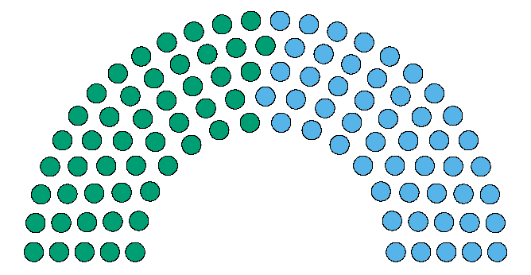

Slide 9
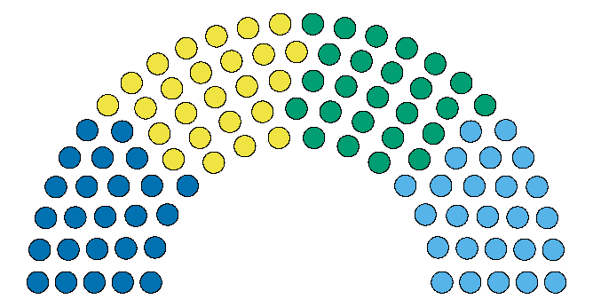

Slide 10
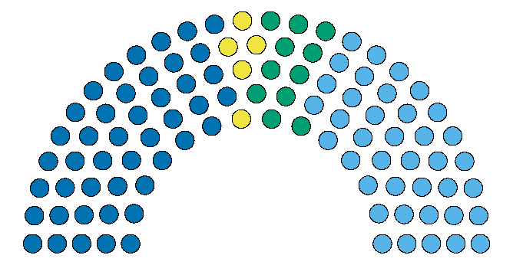
Female stayers
Male few terms
Female few terms
Male stayers

Slide 11
Our premise
What if it takes time for parliamentarians to get the experience required for effective governance.
(Norris, 1997)

Slide 12
Backdrop: What is gender balance?
Endurance (or seniority or experience) has been found to impact a MPs ability to:
Effectively lead and influence a policy process (Jones et al, 2002)
Receive certain rewards and privileges (Heinsohn and Schiefer, 2019)
Be able to choose committee assignments and chairmanships (Squire, 1988)
Lacking experience also impacts the parliamentary experience:
Higher demands and negative treatment (Sweden) (Erikson and Josefsson, 2021)
More loyal and less rebellious (UK) (Puwar, 2004; Cowley and Childs, 2002).
Take time to understand the role (France) (Ollion, 2021; Rosenberg and Blomgren, 2012).
Notes:
Digging into this argument about seniority more thorougly:
There have been studies showing how a MPs experience impacts this person’s work in parliament. Specifically:
READ POINTS
Also, there is some evidence that entering parliament is challenging for newcomers especially.
A study from sweden looking at the intersection of youth and gender found that : young women experience higher demands and anxiety and are more subject to negative treatment compared to other groups (Erikson and Josefsson, 2021).
A study from the UK, focusing on what happened in parliament after the 1997 election, where the number of women in parliament nearly doubled, found that gendered hierarchies influenced parliamentary behaviour. How? Well, the newly elected women MPs were significantly more loyal to the party leadership than any other group in the parliament, including more experienced women parliamentarians.

Slide 13
Three measurements
The continuous measure.
What is the difference between men and women’s political endurance in parliaments?
The relational measure.
What is the share of women among those who have served longer than other parliamentarians?
The static measure.
What is the share of women among parliamentarians who have served for some terms?

Slide 14
Research design
Purpose: Test our measures and demonstrate gender gaps over time, country and measurement.
Ten countries with rich system level variation
The Comparative Legislator Dataset + SIKT
Used generated info on 45.000 legislators. Norway added
Time frame: 1965→
Notes:
Eight European (Czech Republic, Norway, Austria, France, Germany, Ireland, the UK, and Spain) and two North American countries (the USA and Canada).
Case selection ensures rich variation on relevant system-level variables, such as numeric representation of women in parliaments over time, electoral system, electoral volatility and the presence of gender quotas. Secondly, it makes sure we cover countries situated in both north, south, east and central Europe, plus North America, and with different number of MPs in their lower or unicameral chambers.
Prior to 1965 not many women were represented in the selected parliaments, making it hard to ensure variation in endurance (see appendix G). Also, 1965 as a cut off year signifies that we capture the crucial years concerning female emancipation taking place globally, such as the first UN World Conference on Women in Mexico City in 1975 and the 1995 UN Beijing Declaration and Platform for Action
To ensure comparability across the selected countries, we only include data on elected representatives in the lower houses.
Gender gap in endurance: Subtracting the share of female stayers from the share of male stayers. AS you remember, we define stayers as those having served three or more terms in parliament, and rookies as those having served just one or two terms.

Slide 15
Measure 1: Continuous

Slide 16
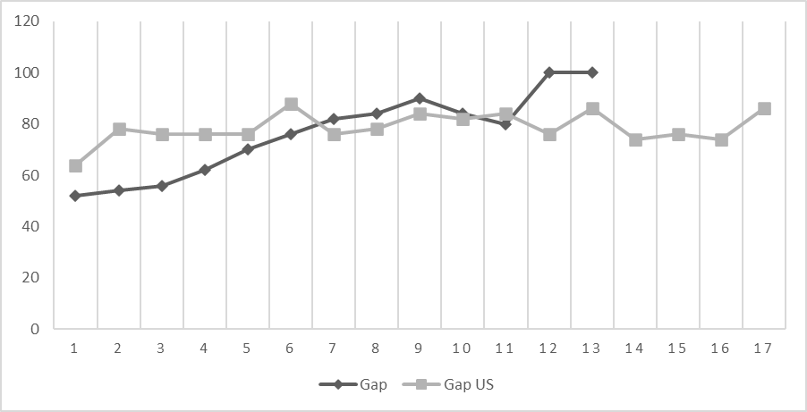
Figure 3: Gender gap in percentage points in endurance, by legislative terms served. All countries.
Source: Comparative Legislator Database. Note: We have excluded those (very few) congressional representatives who have served more than 18 terms, as they are very few. In total, 25 representatives served between 18 and 25 periods in Congress. One of these was a woman.

Slide 17
Measure 2: Relational
Notes:
So, the second assumption argues that the gender gap narrows over time due to increased volatility and increased number of female MPs

Slide 18
Overview of country differences
Country 75th percentile Top 25 percentile
Norway 3 terms 4 to 9 terms
UK 5 terms 6 to 13 terms
Austria 4 terms 5 to 10 terms
Canada 4 terms 5 to 11 terms
Spain 3 terms 4 to 10 terms
France 3 terms 4 to 11 terms
Ireland 5 terms 6 to 13 terms
US 7 terms 8 to 27 terms
Germany 4 terms 5 to 13 terms
Czech Republic 2 terms 3 to 8 terms
Overall (mean) 4 terms More than 5 terms

Slide 19
Overview of gender differences in stayers produced in the periods 1971-1981 and 2001-2011.

Slide 20
Measure 3: Static
Notes:
So, the second assumption argues that the gender gap narrows over time due to increased volatility and increased number of female MPs

Slide 21
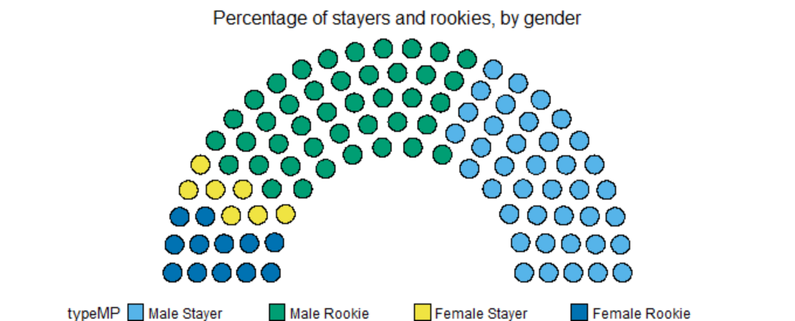
Notes:
Among all parliamentarians in the selected countries since 1965, only 7 percent were female stayers, compared to 39 percent male stayers, represented by yellow and light blue dots respectively in Figure 1 below. The gender gap in endurance thus amounts to 31.5 percentage points.
Another way to emphasise the gender gap is to look at who the representatives who serve not just three, but also five, six seven eight terms are:
We see that as the number of legislative terms served by a MP increases, so does the gender gap. Among those who served six terms, for example, only 12 percent were women and 88 percent were men, creating a gender gap of 76 percentage points. If we move up the ladder to nine legislative terms, the gender gap increases to 90 percent.

Slide 22
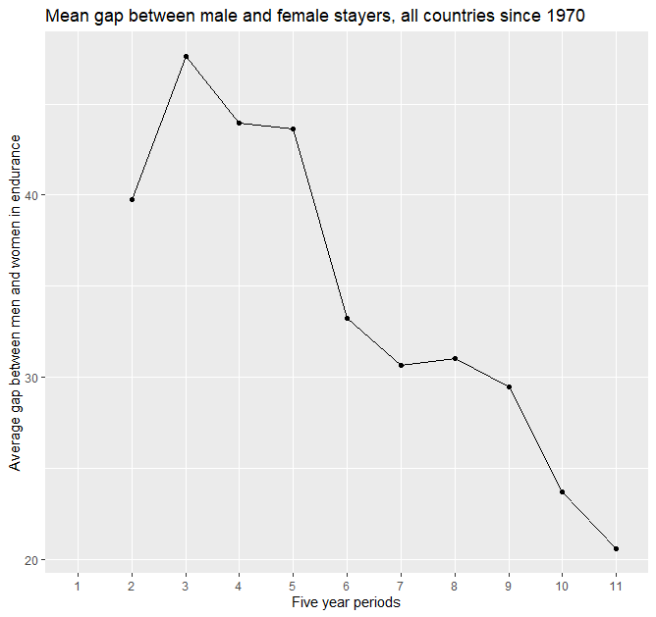
Notes:
This plot shows the mean gender gap among mps present in parliaments within five year periods across the countries. The periods are 1965-1969, 1970-1974, 1975-1979 etc)
In other words, we find support for our first assumption.

Slide 24
Discussion: Drivers of variation
Electoral system
Gender quotas
Volatility
Notes:
Reflecting the discussions previously in the paper, we expect that those countries having a low share of stayers, and a high share of female MPs, will have a smaller gender gap than countries with a high share of stayers and few women in parliament

Slide 25
Conclusion
Introduced new concept
Developed measures
Tested its relevance
Future research – causes and consequences

Slide 26
Thank you!

