Slide 1
Navigating the context conundrum in realist cross-country evaluations
Dr Ana Manzano
School of Sociology and Social Policy
University of Leeds (United Kingdom)
a.manzano@leeds.ac.uk
Twitter: ana__manzano
LIEPP, 18th April 2024

Slide 2
ACKNOWLEDGEMENT
RESPONSE is collaborative study funded by the Medical Research Council (UK) between Hanoi University of Public Health, Ghana Health Service, Mental Health Authority Ghana, University of Ghana, University of Melbourne, University of Leeds and LSHTM.
Ongoing project 2020- 2024 (December)
Mirzoev, T., Manzano, A., Ha, B.T.T., Agyepong, I.A., Trang, D.T.H., Danso-Appiah, A., Thi, L.M., Ashinyo, M.E., Vui, L.T., Gyimah, L. and Chi, N.T.Q., 2021. Realist evaluation to improve health systems responsiveness to neglected health needs of vulnerable groups in Ghana and Vietnam: Study protocol. PLoS One, 16(1), p.e0245755.

Slide 3
Summary
Basic information about cross-country comparisons and about realist evaluation
4 key learning areas (methodological musings).
Realist evaluation and cross-country comparisons
Programme theory and comparisons
Quality & quantity of data and country comparators
Moving from CMOs to middle-range theory (work in progress)

Slide 4
Realist Evaluation
Realist evaluation (Pawson & Tilley, 1997) is a type of theory-driven evaluation that searches for causality using patterns of context-mechanisms-outcomes (CMOs), to test theories.
Evaluation question “How does it work, for whom and under what circumstances?”
CONTEXT is central BUT how does the realist approach mobilises context in cross-country comparisons?

Slide 5
Types of cross-country comparisons
Kohn (1989:20) 4 types of comparisons that shade into each other:
The nation is object of study. How this country compares with the other
The nation is context of study. Scheuch’s (1967) “nation is context”. Interested in the generality of interpretations about how certain social systems operate. E.g. We compare nations to learn more about how hospitals work as an example of the efficiency of public health systems.
The nation is unit of analysis. Seek to establish relationships among characteristics of nations (group of countries classified according to some dimensions)
Those that are transnational in character. Nations as components of larger international systems that are interrelated.

Slide 6
Realist Evaluation and Cross-Country Comparisons
Methodological Musing 1

Slide 7
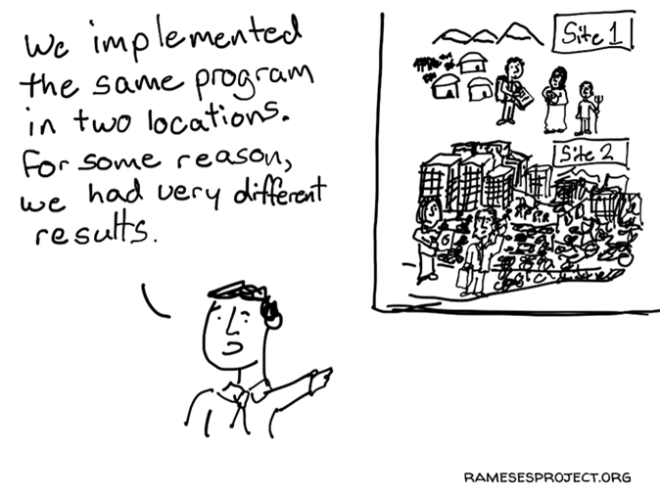
Realist evaluation & Cross-Country Comparisons
Researchers embarking in international projects are often criticized for being unaware of the limitations of comparative research methods and of “contexts”
Not achieving “adequate knowledge of context”
But realist evaluators know that context shapes the mechanisms through which interventions work.

Slide 8
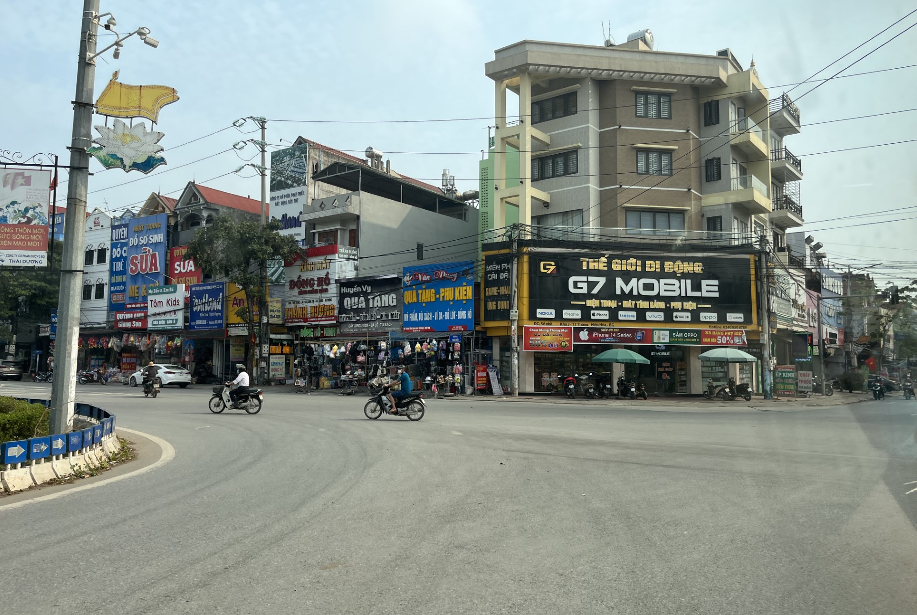
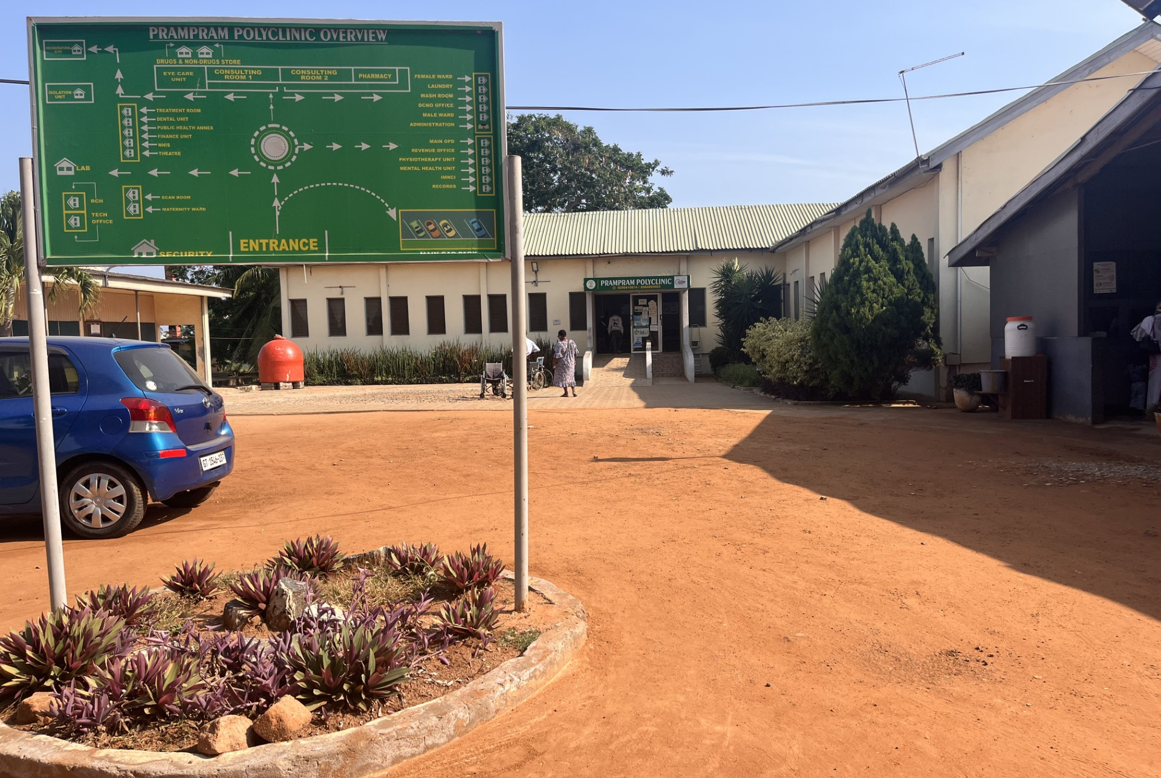
Pawson, 2013: “What works in Wigan on a wet Wednesday will not necessarily work in Truro on a thunderous Thursday” Response Team, 2021: “What works in Hanoi on a wet Wednesday will not necessarily work in Accra on a thunderous Thursday”
HANOI
ACCRA

Slide 9
“Even the maligned comparison of apples and oranges is legitimate if the larger quest is for the essence of the fruit” (Cohen & O’Connor, 2004: XX)

Slide 10
Realist evaluators should be well prepared for these challenges…
The aim of cross-country realist evaluation studies is to uncover causality (test and refine programme theory), knowing that the contexts of the countries are somehow incomparable. Similarities and differences are not just described, they are useful tools to investigate programme theory and to end up establishing middle-range theories (the essence of the fruit).
From context as methodological pain ( “danger” “the problems of coping with context”) to context as “tool” to understand complexity.
Comparison is not a goal in itself, but a means to a larger end.

Slide 11
Programme Theory and Comparisons
Methodological Musing 2

Slide 12
Comparative studies and social theory development
Nowak (1989): gap between comparative social studies and the development of social theory
The utility cross-country research for generating and testing theory. But what theories? Merton (1967) stressed the basic “untestability of most social theories and proposed replacing them with more readily “testable theories of the middle range”

Slide 13
How to test theories in cross-country comparisons
Variable-oriented: Focus on examining the relationships between variables across multiple countries, identifying patterns, at a more general level, rather than focusing on the unique characteristics of individual case
Case-oriented: Instead of focusing on broad statistical trends or aggregate data, cases help understanding how particular variables play out in different national contexts.
Realist evaluation proposes case-oriented comparisons but searching for configurational patterns for middle-range theorization. Aim: “learning how and why it worked in this way” in this country (analytical/configurational) as opposed to “learning about” other countries (descriptive/interpretative).

Slide 14
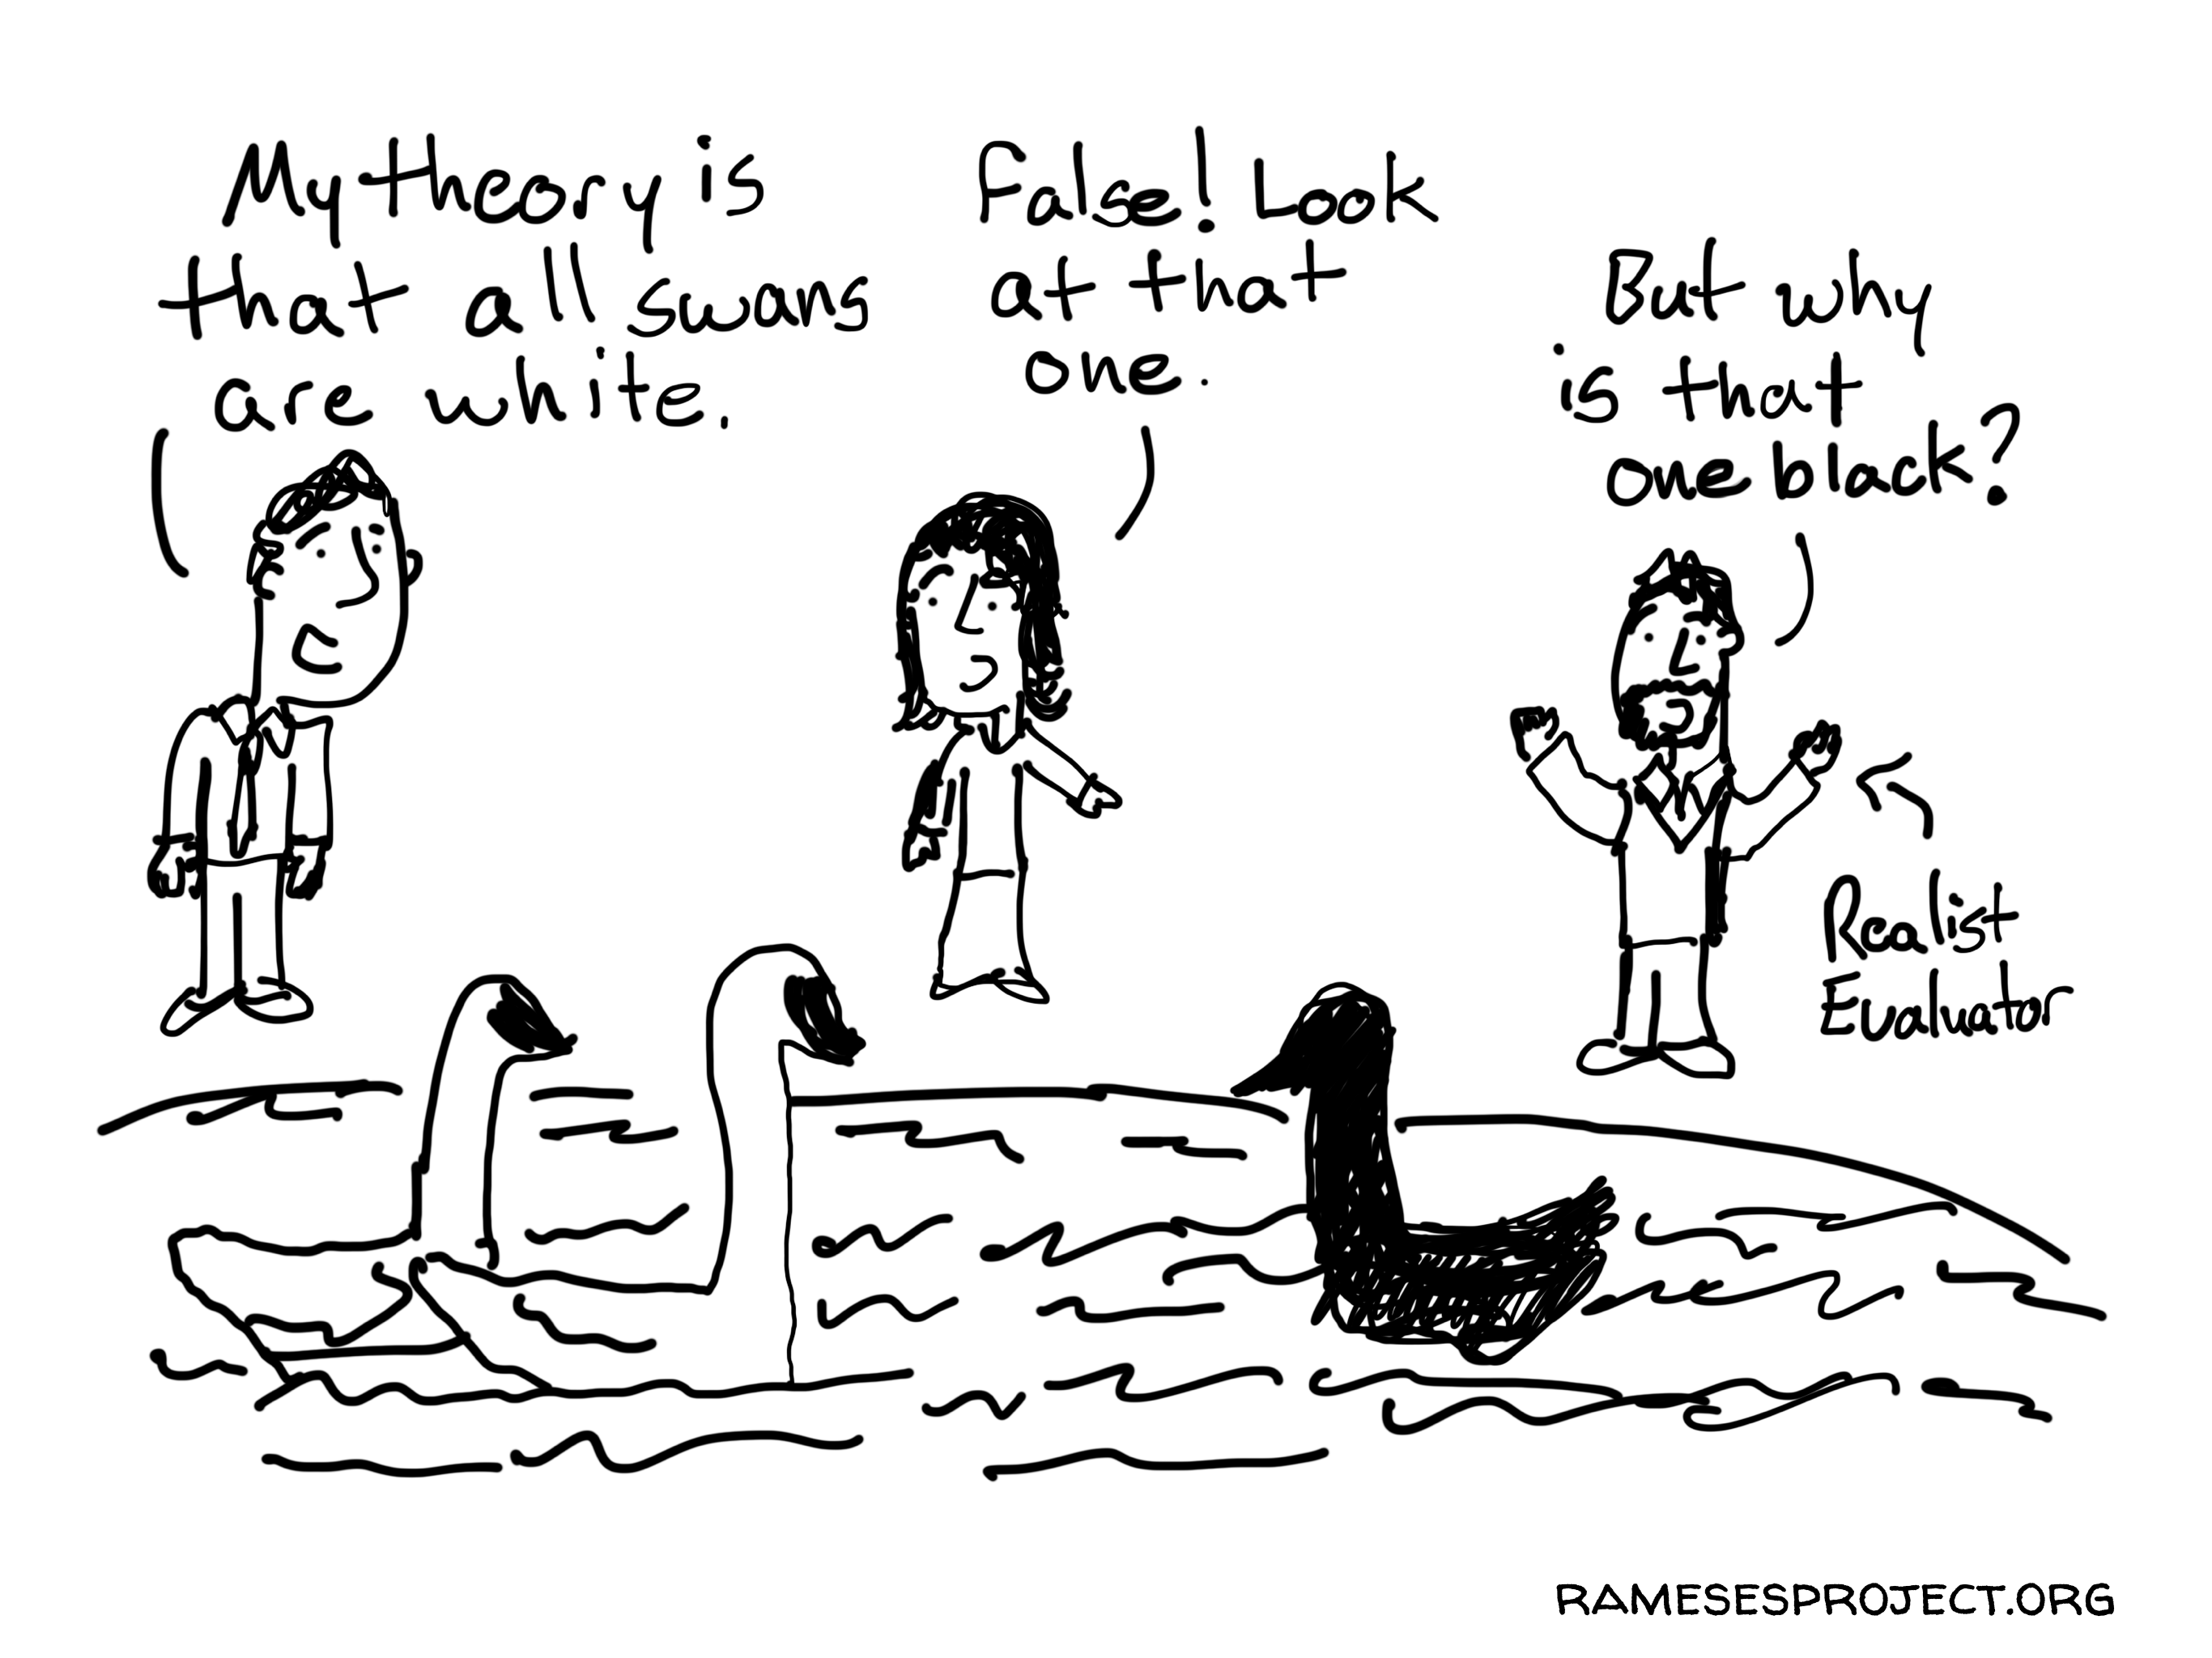
Descriptive/ interpretative goals of comparison emphasize the particularity of each case as a representative of a distinct theoretical type. More focused on differences than similarities.
In realist evaluations, for programme theory development, we are better stressing the basic underline similarities between cases, to decipher important causal patterns.

Slide 15
Quality & Quantity of Data and Country Comparators
Methodological Musing 3

Slide 16
A number of C words difficulties… Context, consistency, comparability and complexity
What is “comparable information” ? Use of the same data collection methods? The same CMOs? The same theories?
To do cross-national comparisons we must “use the same research instruments either to carry out secondary analysis of national data or to conduct new empirical work” Hantrais & Mangen (1996).
Common definitions and compatible measurements are often unavailable
In realist evaluation, consistency and comparability of data produced are less of a problem because you are not trying to convert the apples into oranges for the purpose of the comparison but looking for the essence (causality, mechanisms, etc.)

Slide 17
Rapid scoping review (Realist evaluation AND countries). I found 21 cross-country realist evaluations. Number of countries ranged from 2 to 12, most 2-4.
It is difficult to sustain attention to complexity across a large number of cases
Reducing number of countries as a way of “simplifying complexity”.

Slide 18
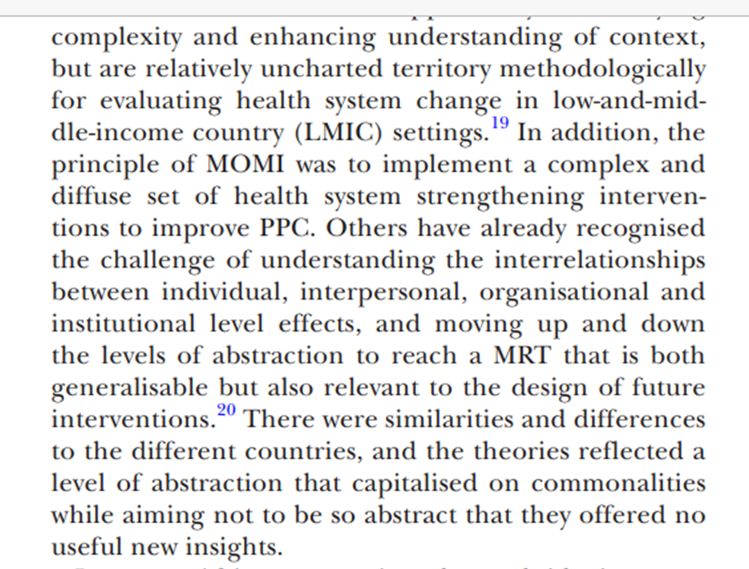
Realist Evaluation in 6 African countries (Robert & Ridde, 2020)
Tendency to either:
Expand evaluation questions so that they are broader and therefore relevant to many countries;
Or restrict investigation to a few significant cases (Ragin, 2014)
Djellouli et al., 2017, 4 countries

Slide 19
RESPONSE Study Example: Broadly similar data collection methods
As the knowledge of context increased, the data collection strategies become more dissimilar

Slide 20
Moving from CMOs to Middle-range theories
Methodological Musing 4

Slide 21
Context-Mechanisms-Outcomes
Challenge: Dealing with multiple causation (multiplied by number of countries)
CMOs: Explanations within country. Middle-range theory: Explanation within and across countries
CMOs for each country will be different but it is key to observe basic underline similarities between CMOs across countries, to decipher general causal patterns.
To embrace context complexity, analysis is iterative: macro, meso, micro contexts

Slide 22
Example of embracing context complexity from a Vietnam programme theory
In a socio-cultural context based on gender norms during pregnancy where often the fetus takes priority over women’s needs from families and women’s themselves, and in a society where maternal mental health is normalised as not seen as pathological; and where there is low literacy of maternal mental health, women are often unaware of the relevance of their own symptoms. Since mental illness language also operates as a taboo, the fear of discrimination and family shame influence self-referral, family referrals and maternal services referral pathways and overall access to health care for pregnant women. Because of the fear of disclosure, women often self-care using alternative therapies instead of seeking support from health services and engaging with healthcare institutions, which in turn offer insufficient coverage for maternal mental health. Health care providers’ focus when engaging with women’s in high-risk groups for MMH (miscarriage, high risk pregnancy, victim of violence, etc.) appears to be primarily on the fetus and women’s physical health outcomes with little attention to their emotional and psychological needs.

Slide 23
Example of embracing context complexity from a Ghana programme theory
In a socio-cultural context based on gender norms that subordinate women and where there are systemic deficiencies that cannot always provide safety nets for women’s basic needs, given that postnatal mental health symptoms are dynamically interconnected; and when the management of these symptoms are understood as being holistic (psycho-social-physical and spiritual) by women, their families and providers; and where pluralistic healthcare provision (biomedical, faith and alternative medicine) coexist and are used in parallel by postnatal women; when women’s uncertainties and beliefs about maternal mental health are respected by all providers; and the services offered consciously recognise and reasonably accommodate these beliefs, and formal public healthcare services are not just based on goodwill but are able to give women a certainty of perceived quality of care THEN women are likely to experience increased feelings of protection and safety that in turn could increase their trust in public health providers of maternal mental health services, translating into higher utilisation of available care, and ultimately to better health systems responsiveness to the needs and expectations of pregnant and postnatal women with mental health conditions.

Slide 25
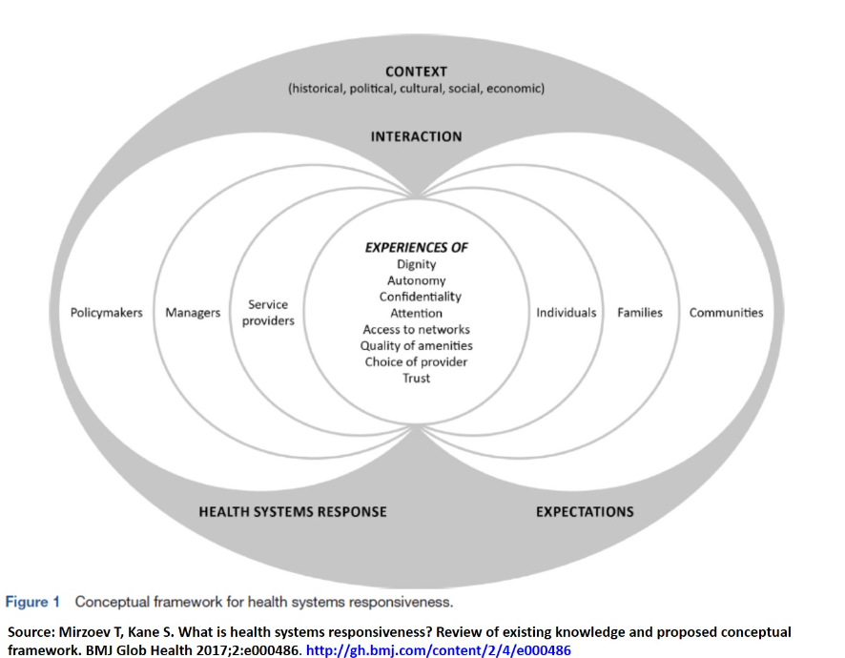
Middle-range theorisation
Use of social sciences theory. Gilmore (2019) criticised the dependence of realist evaluations on WEIRD theories (i.e. theories based on the study of Western, Educated, Industrialized, Rich, Democratic people) within testing and refinement
RESPONSE study Example:
The social sciences theories needed for each country CMOs were different but still mostly WEIRD …, although selected by each country for their specific contextual relevance.
In Ghana we looked at theories related to spirituality in pregnancy and birth, while this was mentioned in Vietnam, the pattern was not that strong.
When there was a similar important concept (e.g. stigma), each country teams selected different stigma social sciences theories to help them with their refinement. This selection often represented a choice/choices that allowed for the contextual specificity of the country.

Slide 26
In summary
Typical cross-country evaluation question “Does this policy work better in one country than in another”?? Realist evaluation cross-country evaluation question: “How does this policy/programme/intervention work differently in each country, for whom, in what circumstances and why?”
When we are comparing to uncover causality, sources are no longer “incomparable”. Sources are “incomparable” only when “context” is perceived as a “thing” to be controlled or standardized;”.
Realist evaluation is a useful approach to deal with the heterogeneity “providing concepts relevant to bringing together the pieces of a complicated puzzle” (Robert & Ridde, 2020)
Adding depth through contextualization but also decontextualization through middle-range theorization with the support of context-driven social sciences theories.

Slide 27
References
Cohen, D. & O’Connor, M. (2004). Comparison and history. Europe in cross-national perspective. Routledge: New York.
Danso-Appiah, A., Thi, L.M., Ashinyo, M.E., Vui, L.T., Gyimah, L. and Chi, N.T.Q., 2021. Realist evaluation to improve health systems responsiveness to neglected health needs of vulnerable groups in Ghana and Vietnam: Study protocol. Plos One, 16(1), p.e0245755.
Djellouli, N., Mann, S., Nambiar, B., Meireles, P., Miranda, D., Barros, H., Bocoum, F.Y., Yaméogo, W.M.E., Yaméogo, C., Belemkoabga, S. and Tougri, H., 2017. Improving postpartum care delivery and uptake by implementing context-specific interventions in four countries in Africa: a realist evaluation of the Missed Opportunities in Maternal and Infant Health (MOMI) project. BMJ global health, 2(4), p.e000408.
Gilmore, B. (2019). Realist evaluations in low- and middle-income countries: reflections and recommendations from the experiences of a foreign researcher. BMJ Global Health, 4(5), e001638. https://doi.org/10.1136/bmjgh-2019-001638
Hantrais & Mangen (1996) Cross-national research methods in the social sciences
Greenhalgh, J. and Manzano, A., 2022. Understanding ‘context’in realist evaluation and synthesis. International Journal of Social Research Methodology, 25(5), pp.583-595.
Pawson, R., 2006. Evidence-based policy: a realist perspective. London: Sage
Pawson, R., Tilley, N. and Tilley, N., 1997. Realistic evaluation. Sage.
Ragin, C.C., 2014. The comparative method. In The Comparative Method. University of California Press.
Robert, E. and Ridde, V., 2020. Dealing with complexity and heterogeneity in a collaborative realist multiple case study in low-and middle-income countries. SAGE Publications Ltd.

